Slide 1
AMAZON
STOCK PRICE ANALYSIS
Nainil Patel

Slide 2
Summary
Dataset
Descriptive Analysis
Timeseries Object
Seasonal Decomposition
ACF/PCF Plots
Exponential Smoothing - Holt Winters
Seasonal Arima
Comparison of Models
Trend Analysis

Slide 3
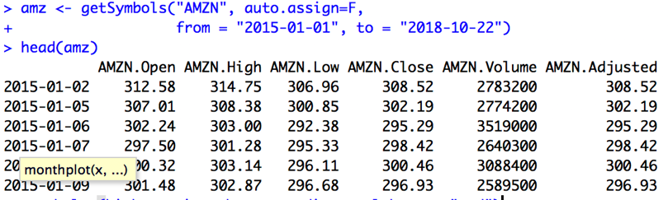
Dataset
Data scrapping
Amazon Stock Prices from 2015 - 01 till 2018 - 09
Library - “quantmod”
Function - getSymbols()
Notes:
Quantitative Financial Modelling and Trading Framework for R
The quantmod package for R is designed to assist the quantitative trader in the development, testing, and deployment of statistically based trading models.
getSymbols is a wrapper to load data from various sources, local or remote. Data is fetched via one of the available getSymbols methods and either saved in the env specified - the parent.frame() by default – or returned to the caller.

Slide 4
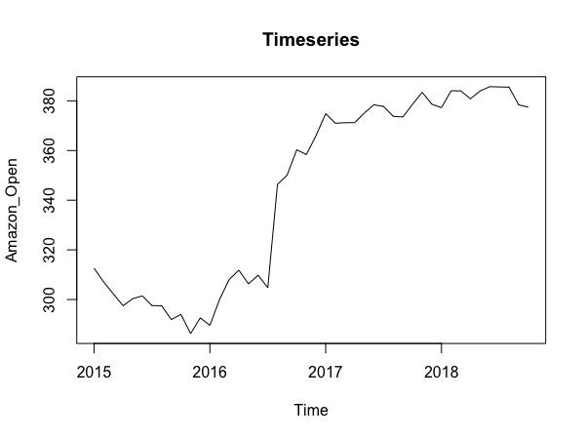
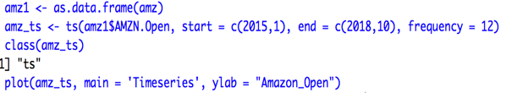
Data Preparation
Converting the data
Xts -> data.frame
Timeseries object

Slide 5
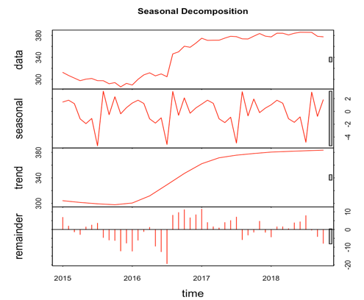
Seasonal Decomposition
Seasonal Decomposition of Amazon’s Opening price of each day
Showcasing trend, seasonality and residual
Notes:
The additive decomposition is the most appropriate if the magnitude of the seasonal fluctuations, or the variation around the trend-cycle, does not vary with the level of the time series. When the variation in the seasonal pattern, or the variation around the trend-cycle, appears to be proportional to the level of the time series, then a multiplicative decomposition is more appropriate. Multiplicative decompositions are common with economic time series.
An alternative to using a multiplicative decomposition is to first transform the data until the variation in the series appears to be stable over time, then use an additive decomposition. When a log transformation has been used, this is equivalent to using a multiplicative decomposition becausey
t=St×Tt×Rtis equivalent tologyt=logSt+logTt+logRt.

Slide 6
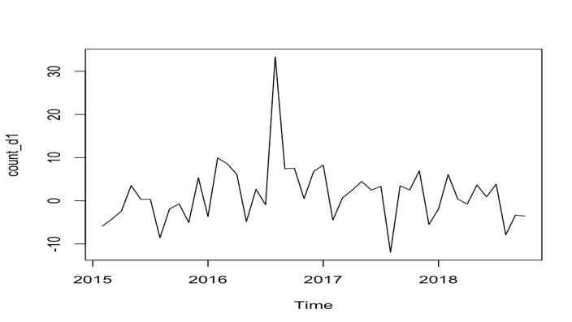
Stationary Data
Using diff() function for making the data stationary

Slide 7
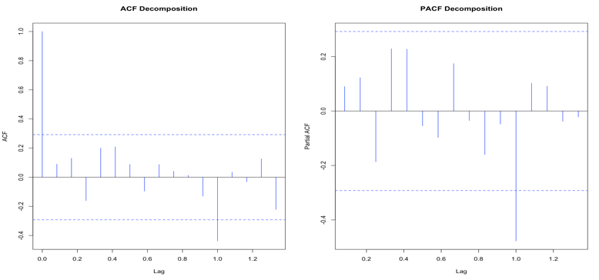
ACF and PACF plots

Slide 8
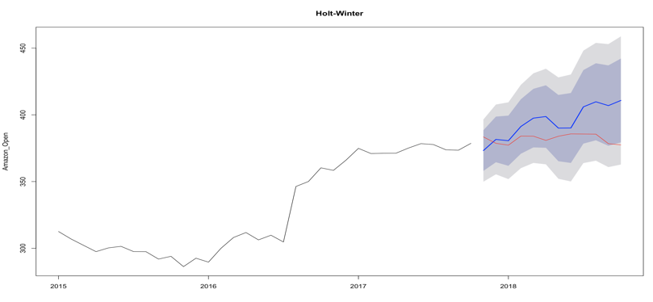
Exponential Smoothing - Holt Winters

Slide 9
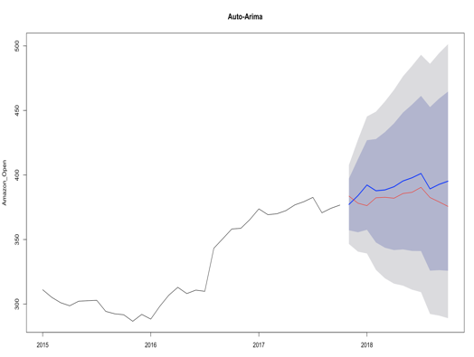
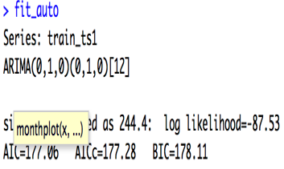
Auto Arima

Slide 10
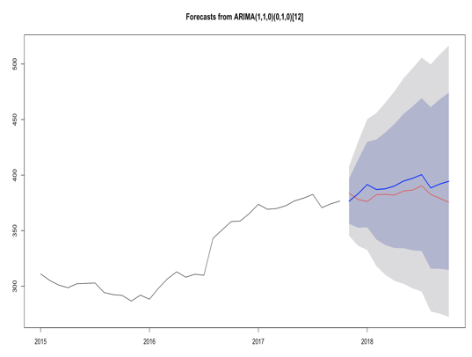
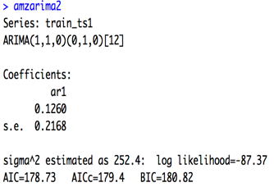
Arima

Slide 11
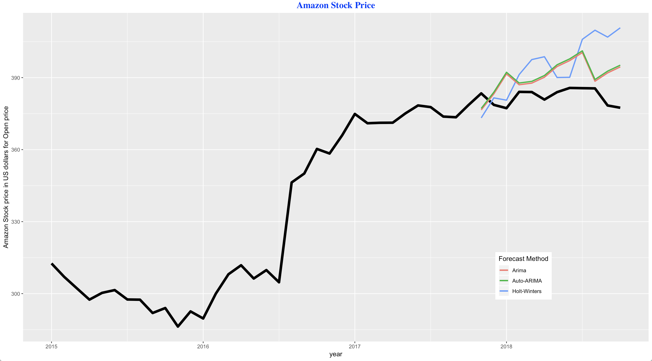
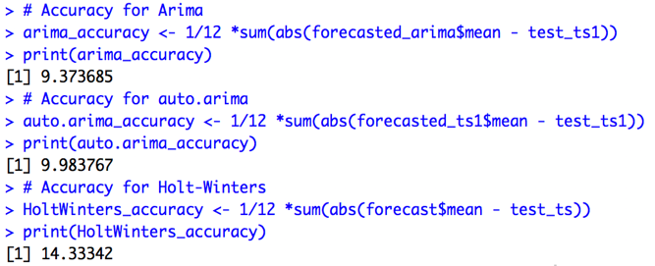
Model Comparison
Arima > Auto-Arima > Holt Winters
Notes:
We will compare all the 3 method by calculating the mean absolute error to check the accuracy.
Arima model has the least mean absolute error so arima is most accurate of all the three,
Then the auto arima and least accurate from the 3 is holtwinters.
It is also evident from the autoplot which displays the forecast of all the methods and in that arima is the best fit, then auto arima and last holt winters.

Slide 12
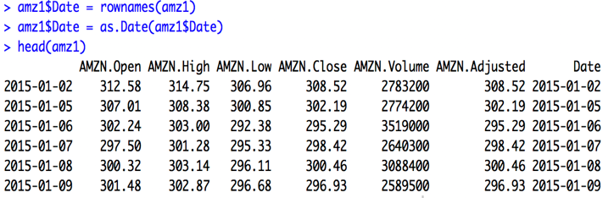
Data Preprocessing
Adding date column
Converting date column into date format
Notes:
In order to solve analytical question about the pattern within the trading days we need to convert the irregular spaced data to regular spaced data so that we can use the frequency parameter for finding the pattern
First step is to use the data frame that we have already created
In that dataframe date is just available as a row name, so we create a new column named date, and convert the new column date into date format

Slide 13
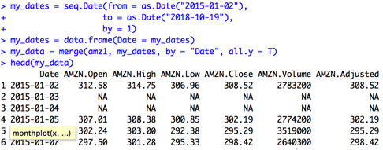
Merge
Create object named my_dates
Converting my_dates to data frame
Merge data frames my_dates and amz1
Identify the missing dates
Notes:
Nest step is to create object my_dates which will contain all the dates for a specified period, we will use seq.date function by passing the parameters from which is the start date and to is the end date and by is the step size.
Now we will convert the object my_date into dataframe
And lastly we will merge the original dataframe contains the data for the traded days and the new my_date datafram consist all the dates within the period, and the new data frame created also contains the non trading days with NA

Slide 14
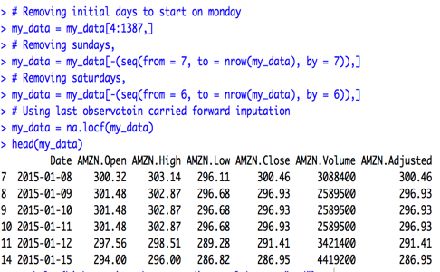
Imputing
Removing initial days so as to start from Monday
Removing Sundays
Removing Saturdays
Imputing using locf() function where last observation is carry forwarded
Notes:
For getting the pattern for a trading week, we need a regularly spaced dataset with a frequency of 5, because there are 5 trading day’s a week,
First step is to chop some of the first few observation in order to a get the dataset started from a full trading week and for that we do index operation.
Now the data set starts from januaur 5th 2015 which is Monday.
Now as we have a regularly spaced data
Now we will get rid of the Sunday and Saturday by using the seq function, and subtract the sequence from the data, in seq function we will pass the parameter from which indicate the fisrt observation to be removed, to specify the last observation of the dataset and by is the step size which will be 7 as 7 is for Sunday in the weekly cycle. and same process for removing Saturday by changing the parameter to 6. Now there are some missing values remaining which are the holidays, and for that we will perform imputation by using locf. Now the data is regularly spaced data with no NA values with a frequency of 5. Which can be used to find pattern between the trading week

Slide 15
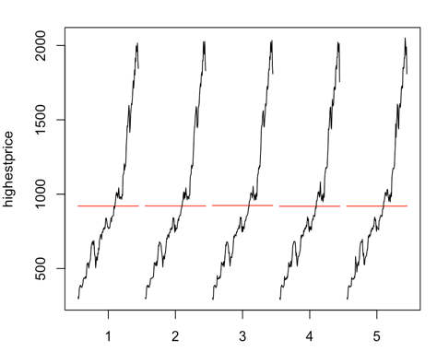
Month Plot (Highest Price)
Convert data to timeseries
Extracting the highest rate of a stock price
X - axis are the trading days of the week
Y - axis is the price of the stock in USD

Slide 16
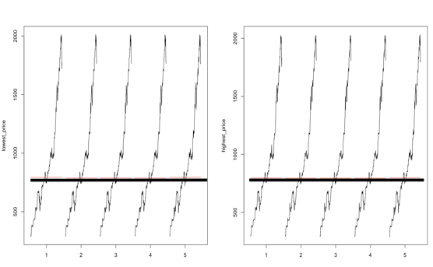
Trend
Comparing highest price to lowest price
Evident from the lowest price month plot that the best buying days for the stock is Tuesday, Wednesday and Thursday
Best selling day for the stock is Monday and Friday

